Slide 1
BioTeam's iNquiry:
Bridging the Gap Between Cluster Computing and the User
Chris Dwan
Principal Investigator, The BioTeam
cdwan@bioteam.net

Slide 2
Conclusions
Modern science, at any level, involves serious computation
Clusters are a commodity
Flexible interfaces empower users and educators
High schools and Big Pharmas can use the same interface, but in different ways
cdwan@bioteam.net

Slide 3
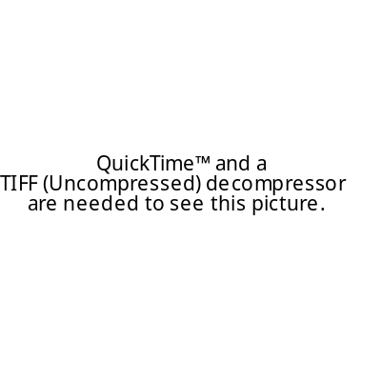

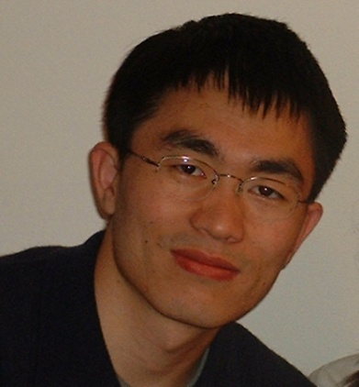
The BioTeam
Small consulting company:
  Scientists, Developers, IT Professionals
Expertise:
  Scientific computing
  Parallel computing
  Infrastructure
cdwan@bioteam.net

Slide 4
Disciplines using HPC
Physics (always)
Chemistry
  Computational Chemistry, Cheminformatics
  Protein structural analysis / visualization
Biology
  Genomics / proteomics
  Biochemistry, proteomics
  Toxicology, veterinary science
Economics, Sociology, Environmental science, …
cdwan@bioteam.net

Slide 5
Computing For Science
Many user models
Many applications, mostly open source
Cooperative, collaborative, yet competitive
Compute and data intensive
Rapid rate of growth / change
Many skill levels: Physicist -> MD
cdwan@bioteam.net

Slide 6
A Vision for Scientific Computing
Scientific Questions
Sequence Analysis, Genomic Profiling,
Computational Chemistry
Scientific Questions
Sequence Analysis, Genomic Profiling,
Computational Chemistry
Scientific Questions
Sequence Analysis, Genomic Profiling,
Computational Biology/Chemistry
Users
Workflow Tools/Scripts
Pipeline Pilot, Perl
Workflow Tools/Scripts
Pipeline Pilot, Perl
Workflow Tools/Scripts
Pipeline Pilot, Perl
Expert Users
Web Services / Structured Interfaces
InQuiry/Pise
Web Services
Pise, InQuiry
Web Services
Pise, InQuiry
Developers
Job Distribution/Management
LSF
Job Distribution/Management
LSF
Job Distribution/Management
LSF / SGE
System Administrators
High Performance Computing
cdwan@bioteam.net

Slide 7

BioTeam’s iNquiry
iNquiry is two things:
  “Instant” cluster deployment kit
    Scheduler, Web Browser, integrated configuration
  Web portal for Bioinformatics
    170+ applications pre-installed
    HTML interface
    SOAP / Web Services interface
    Integrated with Cluster tools
cdwan@bioteam.net

Slide 8
iNquiry: History
BioTeam identified two needs:
  Simple cluster setup
  Web portal for informatics
History
  Based on system at Texas A&M University
  Captured & restored boot images using an iPod
Present
  OS X / Apple, HP, Linux, SGI, Orion Multisystems
  160+ installations worldwide
    140+ are Apple
    2 -> 240 nodes
cdwan@bioteam.net

Slide 9
iNquiry: 2005
PISE (Catherine Letondal, Pasteur Institute) based web portal for 170+ popular command line applications on a cluster
SOAP + WSDL interface to all apps
All interfaces from PISE XML descriptions
HTML
CGI Scripts
PISE XML
PISE Scripts
PERL Modules
WSDL
Cluster
SOAP Interface
cdwan@bioteam.net

Slide 10
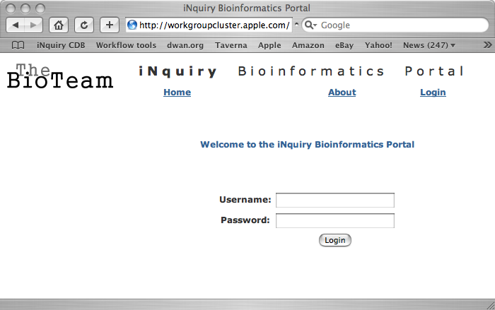
cdwan@bioteam.net

Slide 11
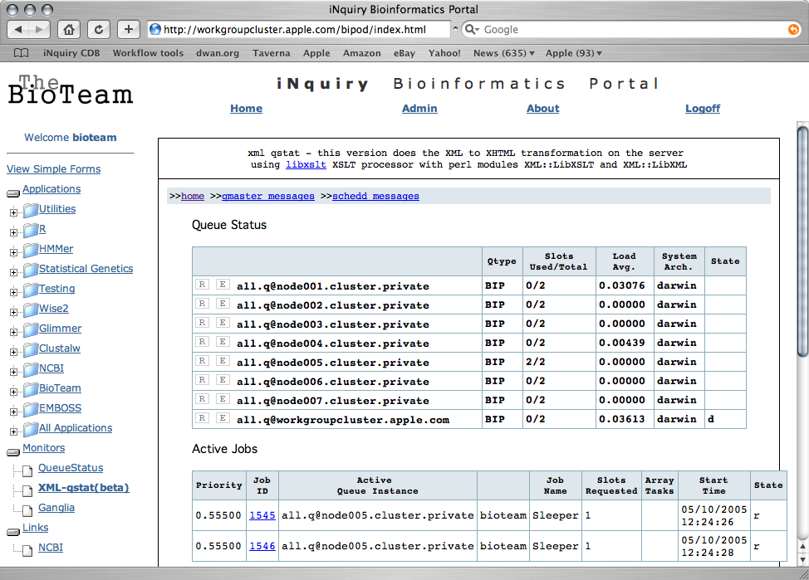
cdwan@bioteam.net

Slide 12
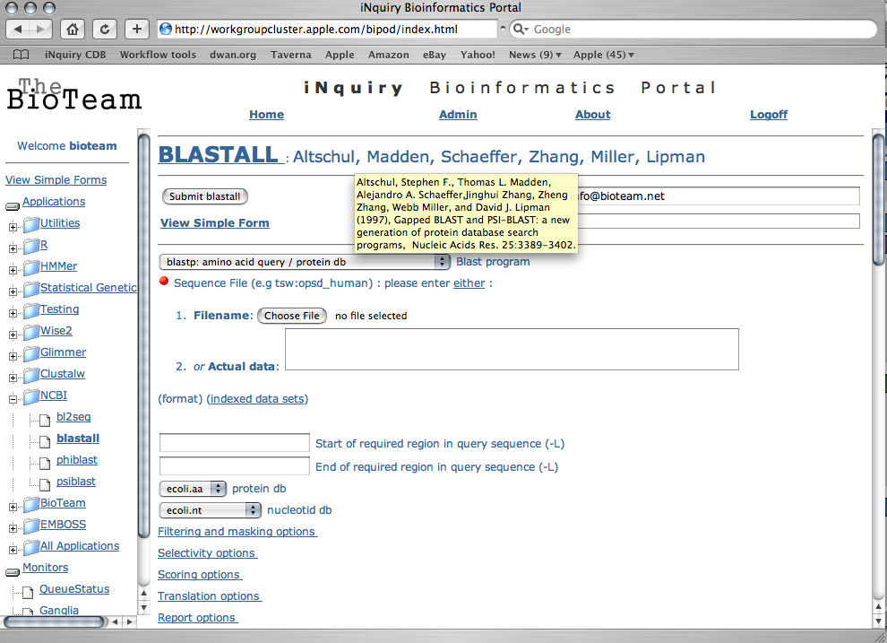
iNquiry Interface
cdwan@bioteam.net

Slide 13
iNquiry Interface
blastall.xml
<pise>
<head>
<title>BLASTALL</title>
<version>2.2.1</version>
<description>with gaps</description>
<authors>Altschul, Madden, Schaeffer, Zhang, Miller, Lipman</authors>
<category>NCBI</category>
<reference>Altschul, Stephen F., Thomas L. Madden, Alejandro A. Schaeffer,J
inghui Zhang, Zheng Zhang, Webb Miller, and David J. Lipman (1997), Gapped BLAS
T and PSI-BLAST: a new generation of protein database search programs, Nucleic
Acids Res. 25:3389-3402.</reference>
<doclink>http://www.ncbi.nih.gov/Education/BLASTinfo/information3.html<
/doclink>
</head>
cdwan@bioteam.net

Slide 14
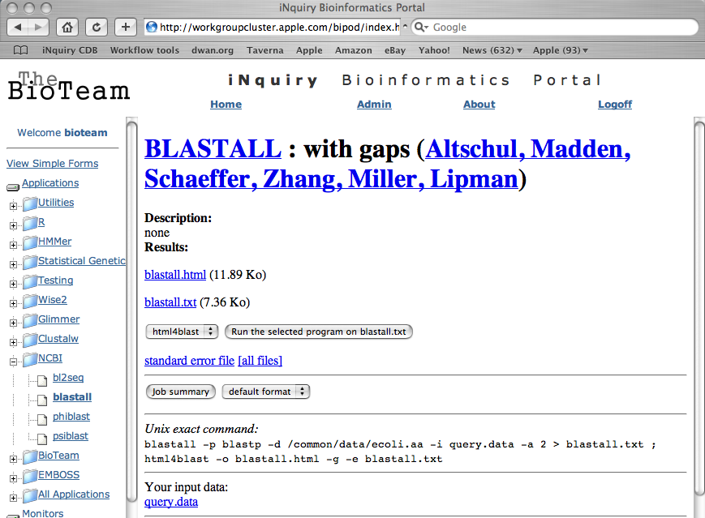
cdwan@bioteam.net

Slide 15

Undergraduate Informatics
Steve Festin - Hamilton College
iNquiry in introductory biology / informatics
“Mach” forensics experiment:
  DNA evidence for HIV infection from dentist to patients
  BLAST, clustalw, PHYLIP
Custom interfaces defined in XML
cdwan@bioteam.net

Slide 16
High School Informatics
Concord-Carlisle High School - Concord, MA
Week long “teach the teachers” session
  Physics, Chemistry:
    Molecular dynamics: AMBER, CHARMM, GROMACS
  Geology:
    Geographic Information Systems
  Biology:
    ClustalW, BLAST, the usual suspects
Developed training materials to use the cluster in their classes.
cdwan@bioteam.net

Slide 17
Clusters
cdwan@bioteam.net

Slide 18
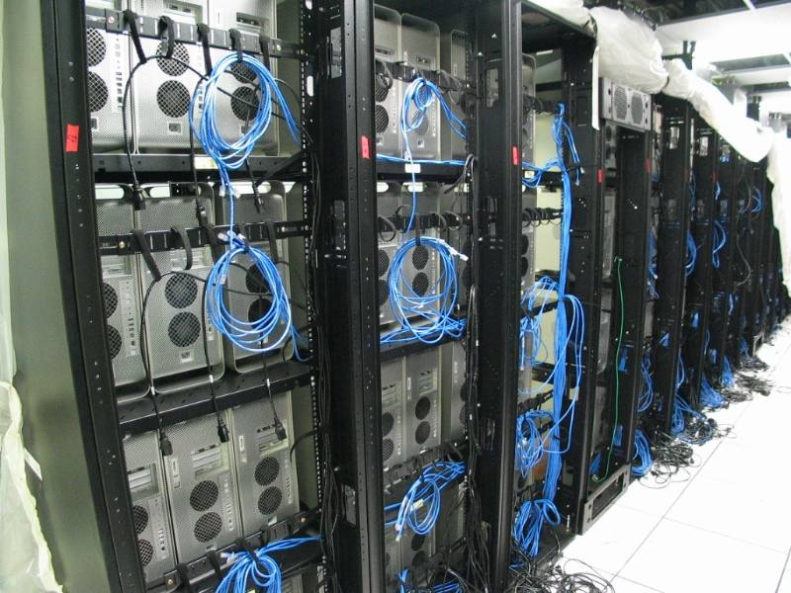
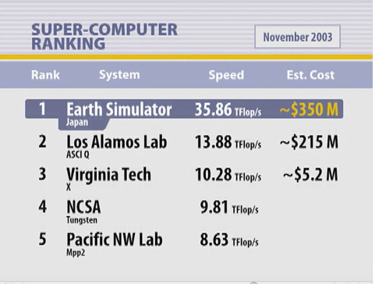
“Big Mac”
Virginia Tech:
  (2003) 3rd fastest supercomputer in the world: $5.4 Million
  Ordered from Apple’s web sales page.
“Virginia Tech has aspirations … …This is one of those spires that one can build that will be visible from afar.”
-Hassan Aref
Dean of Engineering, Virginia Tech
cdwan@bioteam.net

Slide 19

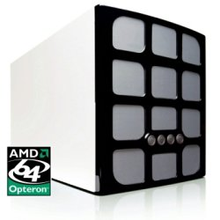
Personal Clusters
Orion Multisystems:
  96 processor cluster
  Deskside form factor
  Runs on a single 20A wall circuit
RocketCalc:
  8 node, dual AMD cluster
  Workstation form factor
Apple:
  Workgroup cluster, 2 - 8 dual processor servers.
  Mini-rack
cdwan@bioteam.net

Slide 20
Web Services
cdwan@bioteam.net

Slide 21
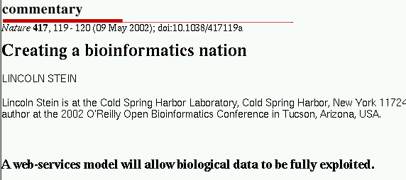
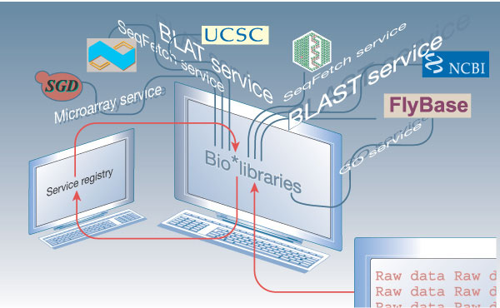
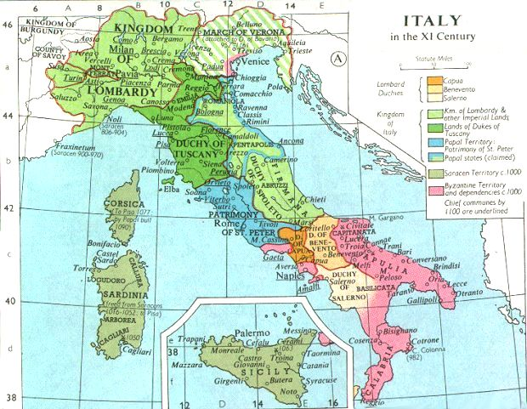







Lincoln Stein’s “Bioinformatics Nation”
Bioinformatics
In the XXI Century
cdwan@bioteam.net

Slide 22
iNquiry: 2005
PISE (Catherine Letondal, Pasteur Institute) based web portal for 170+ popular command line applications on a cluster
SOAP + WSDL interface to all apps
All interfaces from PISE XML descriptions
HTML
CGI Scripts
PISE XML
PISE Scripts
PERL Modules
WSDL
Cluster
SOAP Interface
cdwan@bioteam.net

Slide 23
What is a Web Service?
Programmatic access to remote services with formally advertised interfaces.
  SOAP: Simple Object Access Protocol
    Computational requests and data can be passed using whatever “wire” protocol is available. Generally HTTP through a Web Server
  WSDL: Web Services Description Language
    XML DTD specifying parameters for SOAP functions.
cdwan@bioteam.net

Slide 24
Why Web Services
Interoperability / Scalability
  Minimal buy-in requirements: WSDL / SOAP
  Relocation of services (just point at a different server)
Workflows
  Visual programming
  Capture standard protocols
  Integrate multiple service providers.
Service Discovery
cdwan@bioteam.net

Slide 25

What Web Services Don’t Do
Traditional scheduler tasks:
  Job Control
  Queuing
  Scheduling
  Failure handling
cdwan@bioteam.net

Slide 26
What Web Services Do Not Do
Semantics
  Service ‘X’ must still be interpreted and used in some context.
  No OMG-like object model imposed by default!
  In bioinformatics, other related projects (BioMOBY, etc) attempt to deal with semantic issues.
cdwan@bioteam.net

Slide 27
What Use Web Services?
Languages
  PERL, C, C++, Objective C, Ruby, Java, Applescript, Python, …
Open Source Graphical Clients
  Taverna
Commercial SOAP / WSDL Clients
  Inforsense, Pipeline Pilot, TurboWorx, VIBE, OS X
cdwan@bioteam.net

Slide 28
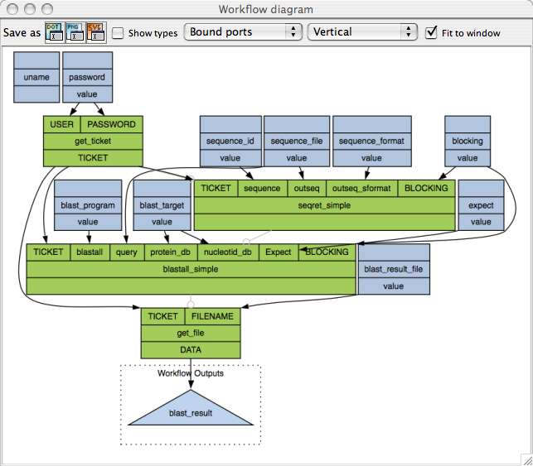
Example Taverna Workflow: Running Blast
cdwan@bioteam.net

Slide 29
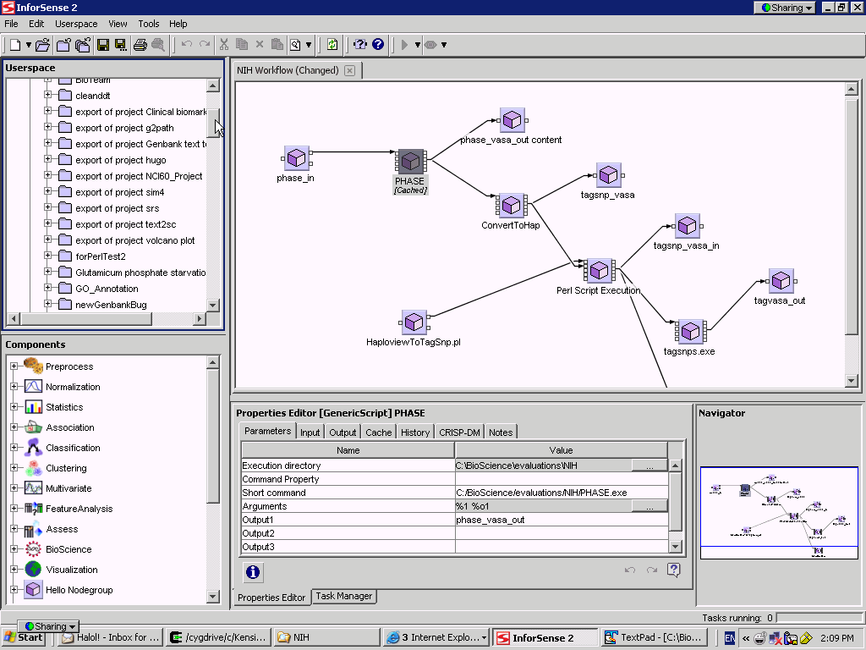
Inforsense Workflow - Microarray Normalization
cdwan@bioteam.net

Slide 30
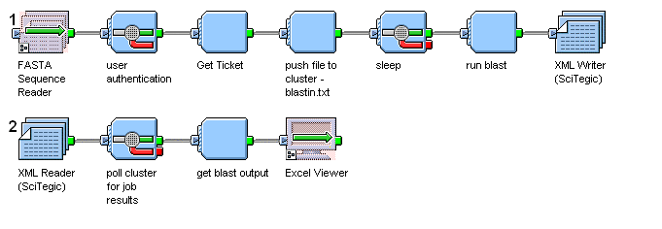
Communicating with InQuiry Web Services (Pipeline Pilot)
Submit
BLAST
Jobs
Transfer
Data
Authenticate
Get Results Back
cdwan@bioteam.net

Slide 31
cdwan@bioteam.net

Slide 32
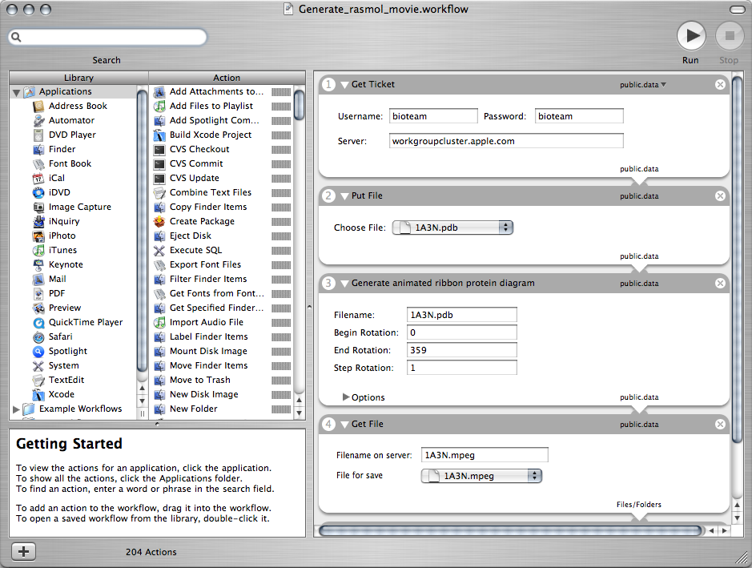
OS X Tiger - Automator
cdwan@bioteam.net

Slide 33
PERL Web Service Client
$res = $server->blastall_simple(
SOAP::Data->name(TICKET)->value($ticket),
SOAP::Data->name("BLOCKING")->value(0),
SOAP::Data->name("blastall")->value("blastn"),
SOAP::Data->name("query")->value("$query_id"),
SOAP::Data->name("protein_db")->value("yeast.nt"),
SOAP::Data->name("nucleotid_db")->value("yeast.nt"),
SOAP::Data->name("tmp_outfile")
->value($query_id.".blastx")
);
cdwan@bioteam.net

Slide 34
A Vision for Scientific Computing
Scientific Questions
Sequence Analysis, Genomic Profiling,
Computational Chemistry
Scientific Questions
Sequence Analysis, Genomic Profiling,
Computational Chemistry
Scientific Questions
Sequence Analysis, Genomic Profiling,
Computational Biology/Chemistry
Users
Workflow Tools/Scripts
Pipeline Pilot, Perl
Workflow Tools/Scripts
Pipeline Pilot, Perl
Workflow Tools/Scripts
Pipeline Pilot, Perl
Expert Users
Web Services / Structured Interfaces
InQuiry/Pise
Web Services
Pise, InQuiry
Web Services
Pise, InQuiry
Developers
Job Distribution/Management
LSF
Job Distribution/Management
LSF
Job Distribution/Management
LSF / SGE
System Administrators
High Performance Computing
cdwan@bioteam.net

Slide 35
Enterprise Informatics
BMS & Novartis:
Web services interface used to expose cluster and SMP resources for processing pipelines
Provides an acceptable way to bridge IT concerns and abstract technical realities.
cdwan@bioteam.net

Slide 36
Good Ideas
Maximize user freedom
  Let users help each other:
    shared SVN repository
    mailing list
  Provide all source code
Include all possible resources
  Never try to get in the way of your users
Assume that users know what they’re doing
cdwan@bioteam.net

Slide 37
Conclusions
Modern science, at any level, involves serious computation
Clusters are a commodity
Flexible interfaces empower users and educators
High schools and Big Pharmas can use the same interface, but in different ways
cdwan@bioteam.net

Slide 38
Predictions
Every undergraduate science degree will include at least one, full term, programming course
Most research groups / labs will have:
  a deskside cluster
  a high end visualization workstation
Web services will be just as scary and powerful as the web itself.
cdwan@bioteam.net

Slide 39
Thank You
cdwan@bioteam.net

